Slide 1

Introduction to NLP
Klara Venglarova
Image created by bing.com/create

Slide 2
Outline
What‘s NLP?
Common NLP tasks
Key concepts + Hands-on exercises
Regular Expressions

Slide 3

What‘s NLP?
Natural Language Processing
„The application of computational techniques to the analysis and synthesis of natural language and speech.“ Oxford Languages, https://languages.oup.com/google-dictionary-en/

Slide 4
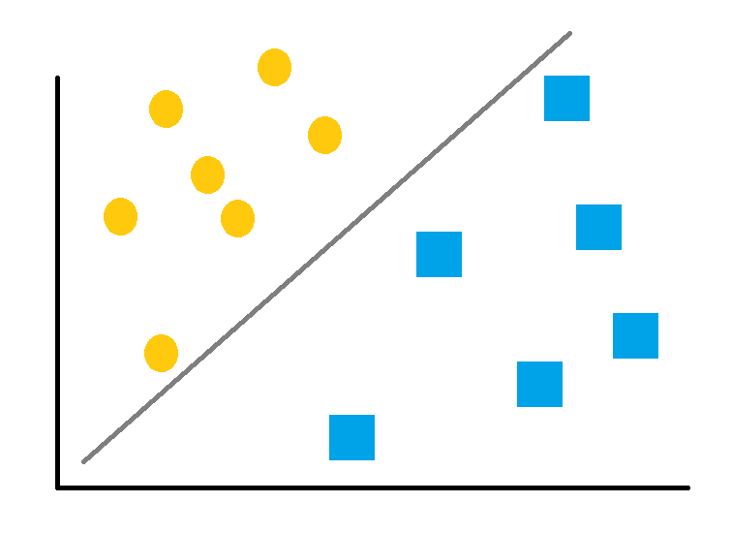
Common NLP Tasks: Text Classification
Automatic classification of a text into pre-defined categories
Spam Detection: Classifying emails or messages as spam or not spam.

Slide 5
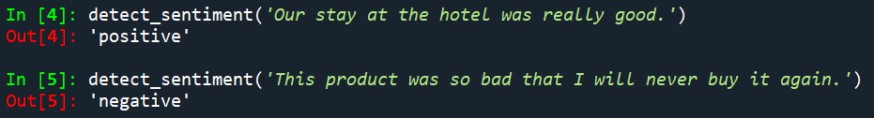
Sentiment Analysis
Identifying the sentiment or emotion expressed in text (e.g., positive, negative, neutral).

Slide 6
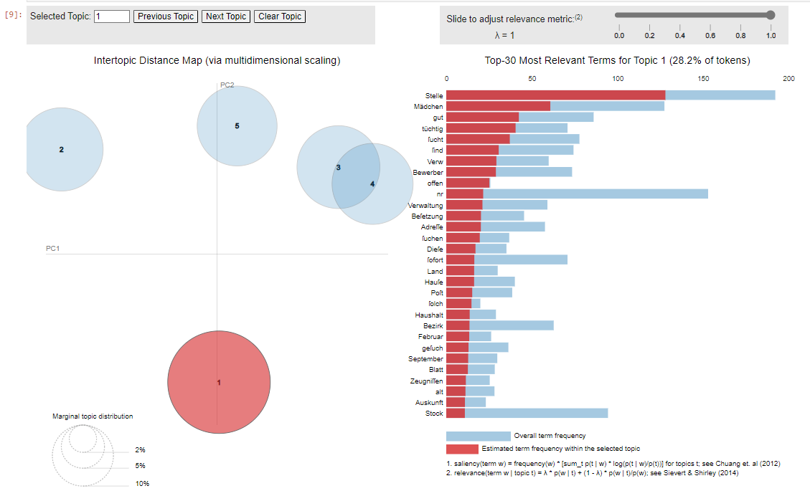
Topic Modeling
Unsupervised learning technique that aims to discover the underlying topics present in a collection of texts without any prior labeling.

Slide 7
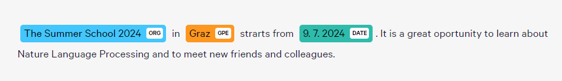
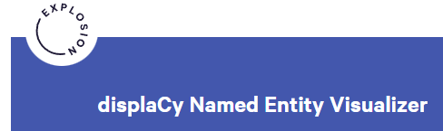
Named Entity Recognition (NER)
Identifying and classifying entities in text into predefined categories such as names of people, organizations, locations, dates, etc.
Source: https://demos.explosion.ai/displacy-ent

Slide 8
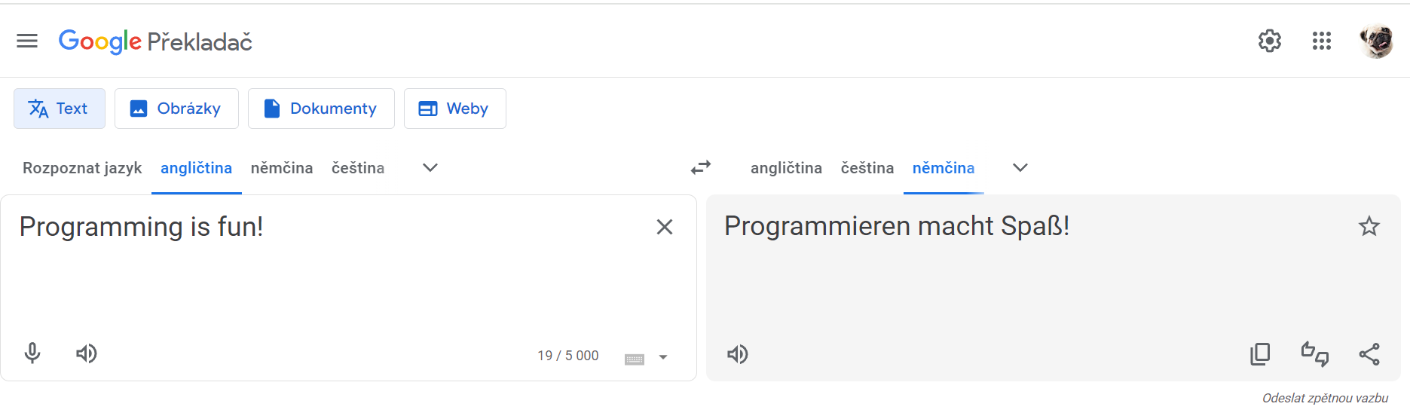
Machine Translation
Translating text from one language to another, such as English to Spanish.
Source: google.translate.com

Slide 9
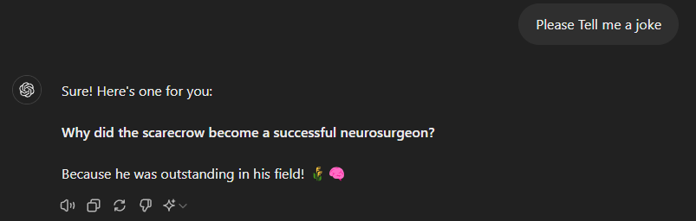
Text Generation
Creating new text based on a given input, including applications like chatbots and story generation.
Source: https://chatgpt.com/

Slide 10
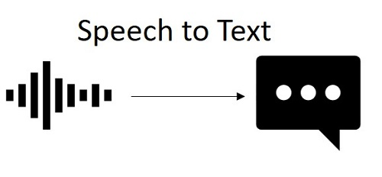
Speech Recognition
Converting spoken language into text.
Source: https://www.whichvoip.com/articles/speech-to-text-transcription.htm

Slide 11

Text-to-Speech
Converting text into spoken language.
https://murf.ai/resources/top-text-to-speech-software-for-speech-impaired/

Slide 12
Revision: I would like to…
Get notified when somebody writes a negative review about my hotel
Identify all peaple's names in a paper
Translate a Spanish voice message into written English
Sentiment Analysis
Named Entity Recognition
Machine Translation
Speech Recognition

Slide 13
Revision: I would like to…
Find the main topics in a large corpus of charters
Study people‘s attitude to taxes increase according to newspaper articles
Identify all places in someone‘s biography
Named Entity Recognition
Sentiment Analysis
Topic Modeling

Slide 14
Key NLP Terms
Image created by bing.com/create

Slide 15
Corpus
A large and structured set of texts

Slide 16
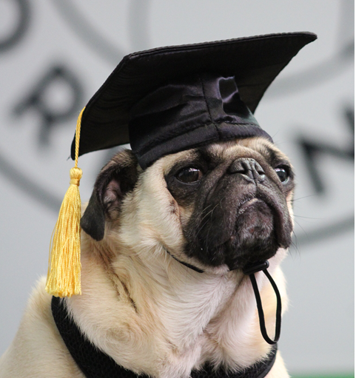
Token, tokenization
Token = the smallest unit of text, such as a word or punctuation mark
Tokenization = the process of breaking text into these units
„a smart dog“ >> „a“, „smart“, „dog“
Token =? Word
Matter of view: Henry V = one word or two?

Slide 17

Types and tokens
Token = every single unit in a text, individual instances
Type = a dictionary of all words used in a text, all different words in a text
Example (token = words):
„A smart dog is using a smart phone.“
Tokens: a, smart, dog, is, using, a, smart, phone
Types: a, smart, dog, is, using, phone
Source: https://www.freepik.com/premium-ai-image/dog-holding-phone-with-collar-that-says-call-me-it_69638025.htm

Slide 18
Exercise
„A long time ago in a galaxy far, far away…“
How many tokens?
How many types?
Tokens: a, long, time, ago, in, a, galaxy, far, far, away {10}
Types: a, long, time, ago, in, galaxy, far, away {8}

Slide 19

Lemma, lemmatization
Lemma = the base or dictionary form of a word
Lemmatization = the process of reducing words to their lemmas
Example:
"running", "ran", and "runs" → "run"
Source: https://static.vecteezy.com/system/resources/previews/012/742/199/non_2x/running-icon-free-vector.jpg

Slide 20
Stem, stemming
Stem = the root form of a word
Stemming = the process of reducing words to their root form, often by removing suffixes
Example:
"changing", "changed", "change"→ "chang"
(Affix = a morpheme attached to a word stem, affixes = preffixes + suffixes: em-power-ment)

Slide 21
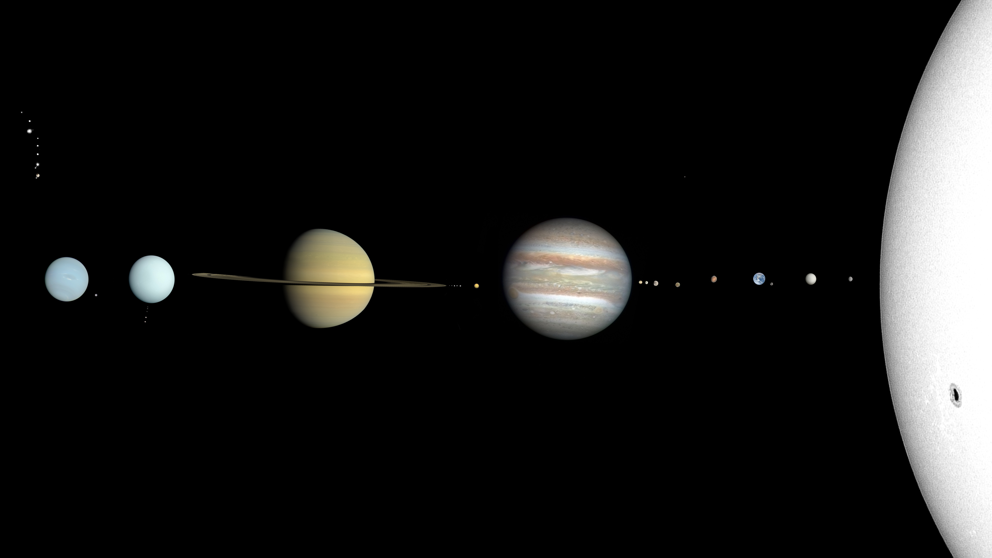
Exercise
The solar system has eight planets.
How many tokens?
How many types?
Which tokens is different from its lemma?
6 tokens
6 types
Planets → planet
Source: https://upload.wikimedia.org/wikipedia/commons/1/19/Solar_System_true_color.jpg

Slide 22

Uppercase, lowercase
Converting given characters into UPPERCASE, lowercase.
Original sentence:
A cat Mikesch slept on the couch.
Uppercase:
A CAT MIKESCH SLEPT ON THE COUCH.
Lowercase:
a cat mikesch slept on the couch.
Source: https://st2.depositphotos.com/27201292/46332/i/450/depositphotos_463323874-stock-photo-closeup-shot-black-fluffy-cat.jpg

Slide 23
Stop Words
Stop words = common words that are often removed from text during preprocessing because they are considered to have little informational value.
Example: "the", "is", "in", "and"

Slide 24

Exercise
Which words would you consider stop words?
Anyway, the weather will be nice.
Anyway, the weather will be nice.
Source: https://cdn-icons-png.flaticon.com/512/10127/10127236.png

Slide 25

Pre-processing
Preparing texts in a suitable format for further analysis
Involves several steps, such as tokenization, lemmatization, stop-words removal

Slide 26
POS Tagging
Part-of-speech tag
Example:
smart >> smart_ADJ, dog >> dog_N

Slide 27
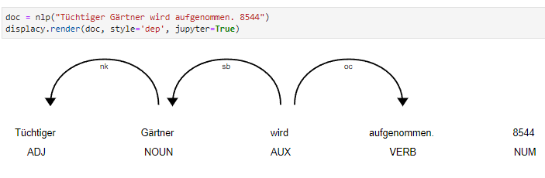
Dependency Parsing
Modelling grammatical relationships in a sentence
Example:
Dog slept -> dog = subject, slept = predicate

Slide 28
N-Gram
N-gram = a contiguous sequence of N items from a given text.
These items can be characters, syllables, or words.
Example:
Sentence: "The cat sat" → bi-grams (2-grams): ["The cat", "cat sat"].

Slide 29
Exercise
The solar system has eight planets.
Bi-grams:
Tri-grams:
[„The solar“, „solar system“, „system has“, „has eight“, „eight planets“]
[„The solar system", „solar system has“, „system has eight“, „has eight planets“]

Slide 30
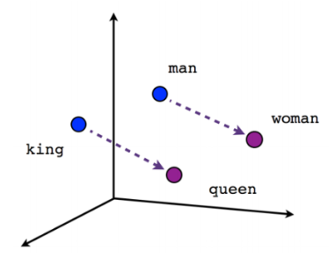
Word Embeddings
Word embeddings = dense vector representations of words that capture their meanings, semantic relationships, and context.
Example: cat: [0.245, -0.103, 0.897, -0.304, 0.574, 0.126, -0.569, 0.781, -0.234, 0.504]
Source: https://ai.engin.umich.edu/2018/07/23/word-embeddings-and-how-they-vary/

Slide 31
Revision
Lemma
Bi-gram
The, is, a, she
He_NOUN reads_VERB
NER
POS tagging
[0.32947, 0.2678…]
Running → Run
Stop Words
Word Embedding
Claud Monet was born in Paris.
["The cat", "cat sat", "sat on", "on the", "the mat"]
person
place

Slide 32
Regular Expressions
Regular expression (regex) = patterns used to match and manipulate text based on specific sequences of characters
Useful for searching, replacing, formating…
https://regex101.com/

Slide 33
Literal Characters
Matches exactly what is written.
Example:
The regex „hello“ matches the string „hello“

Slide 34
Literal Characters: Execise
https://regex101.com/
Regex: dog
Test Strings: My dog is smart. → match
My cat is smart. → no match

Slide 35
Wildcard („.“)
Matches any single character except a newline.
Example:
h.llo matches hello, hallo, hxllo…
? How do I then use . as a dot? With slash: \.

Slide 36
Wildcard („.“): Exercise
Which regex matches words „cat“, „cot“, „cut“ in the text?
Test string:
The cat clept on the mat.
I bought a cot for our baby.
Can you cut the potatoes?
Solution: c.t

Slide 37
Quantifiers
Asterisk (*): matches 0 or more of the preceding element.
ho* matches h, ho, hoo, hooo…
Plus (+): matches 1 or more of the preceding element.
ho+ matches ho, hoo, hooo (but not h)
Question Mark (?): matches 0 or 1 of the preceding element.
ho? matches h and ho (but not hoo)
Curly Brackets ({n,m}): matches between n and m of the preceding element.
ho{2,4} matches hoo, hooo, hoooo

Slide 38
Quantifiers: Exercise
With use of quantifiers, match:
222 in the string: My phone number is 367-222-622.
his and is in the string: I know his mom is nice.
Solution:
2{3}
h*is

Slide 39
Character Classes
Square Brackets ([]): matches any one character inside the brackets.
[aeiou] matches any vowel
Negated Character Class ([^]): matches any character not inside the brackets
[^aeiou] matches any consonant

Slide 40
Character Classes: Exercise
Which regex matches words „cat“, „cot“, „cut“ in the text? Use Character class.
Test string:
The cat clept on the mat.
I bought a cot for our baby.
Can you cut the potatoes?
Solution:
c[aou]t

Slide 41
Predefined Character Classes
Digit (\d): matches any digit.
\d in 221B Baker Street matches 2, 2, 1
Word Character (\w): matches any word character (alphanumeric+underscore)
\w in 221B_Baker_Street matches all characters
Whitespace (\s): matches any whitespace character (space, tab, newline)
\s in 221B Baker Street matches space, tab

Slide 42
Predefined Character Classes
Non-digit (\D): matches any non-digit.
\D in 221B Baker Street matches all characters except for 2, 2, 1
Non-word Character (\W): matches any non-word character
\W in 221B! Baker?#Street matches !, , ?, #

Slide 43
Predefined Character Classes: Exercise
Match both dates: She was born in 1995 and died in 2024.
Match all words with hashtags: The #bestsingererver had #today a concert in #MesseGraz!
Match the email address: My email is summer.school@uni-graz.at.
Solution:
\d{4}
#\w+
\w+\.\w+@\w+\W\w+\.\w+

Slide 44
Anchors
Caret (^): matches the strart of the string.
^hello matches hello in hello world
Dollar Sign ($): matches the end of the string.
world$ matches world in hello world

Slide 45
Anchors: Exercise
Match Hello in the string Hello world, but not in Well, Hello there.
Match any last three digits in a phone number. Test string: +43 876 985 564
Solution:
^Hello
\d{3}$

Slide 46
Regex Generator
https://regex-generator.olafneumann.org
(or: https://chatgpt.com/)

Slide 47


Contact
Klara Venglarova
klara.venglarova@uni-graz.at

